Slide 1
Bank Marketing
University of Chicago
Python for Analytics – Final Report
By Fabiyi Oluwafemi
March 2021

Slide 2



Executive Summary > Problem Statement & Project Objectives
Executive Summary
The Banking Dataset of different customers is related to direct marketing campaigns (phone calls) of a Portuguese banking institution. The classification goal is to predict if the customer will subscribe to a term deposit so it can channel its effort to wards the right customers and through the most effective channel.
Project Approach
Key Takeaways
1
Collect data on the Bank’s
customers based on prior campaign outreaches
2
Gain insight into the
nuances customer behavior
3
Determine if customer will subscribe to term deposit

Slide 3





Project Approach > Overall Work Approach
Executive Summary
Project Approach
Plan
Design
Build
Implement
Overall Approach
Project Organization
Data Collection and Design Consideration
Core Analytics Task Execution
Make Actionable
Methodology
Key Takeaways
Project Topic Review and Understanding
High level
Data Review
Environment Installation
Model
Assessment & Selection
Project work approach organization
Design Considerations
Data
Cleaning
Project
Presentation
Feature
Engineering
Exploratory Data Analysis
Model
Development
Start
0.5 Week
1 Week
1.5 Weeks
0.5 Week
End
Completed
Completed
Completed
Current Status
Notes:
Our team structured the delivery of this project across the following 4 project phases with the core Analytics task spread across the design and build phases

Slide 4





Project Approach > Data Cleaning
Executive Summary
Project Approach
Overall Approach
1
Bank Marketing Additional
41,188 by 20
1
Bank Marketing Additional
41,188 by 21
1. Extract
3. Load
Methodology
Key Takeaways
Source
Destination
2. Transformation
Accessing uniqueness of records
Checking for NA values in the dataset
Assessing correlation relationships in the dataset
Visualizing possible relationships in the dataset
Dropping columns not need for analysis
Encoding columns with dummies values

Slide 5
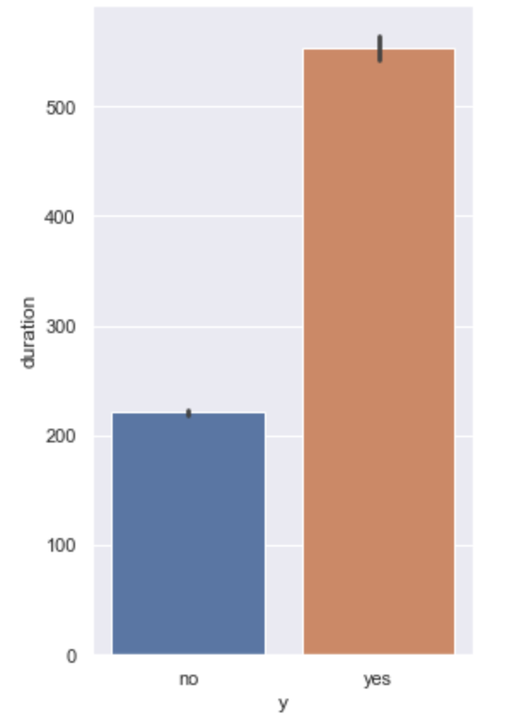
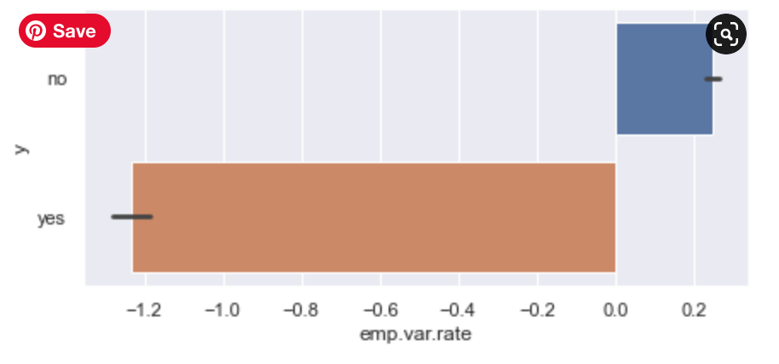
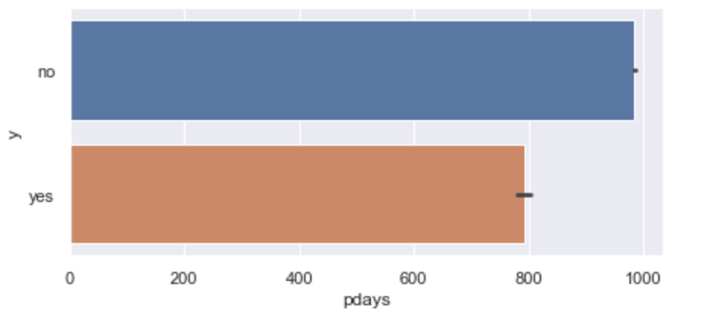
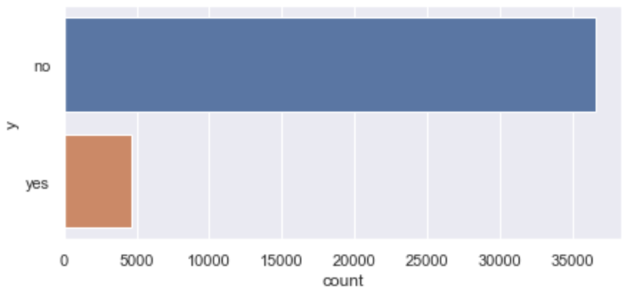
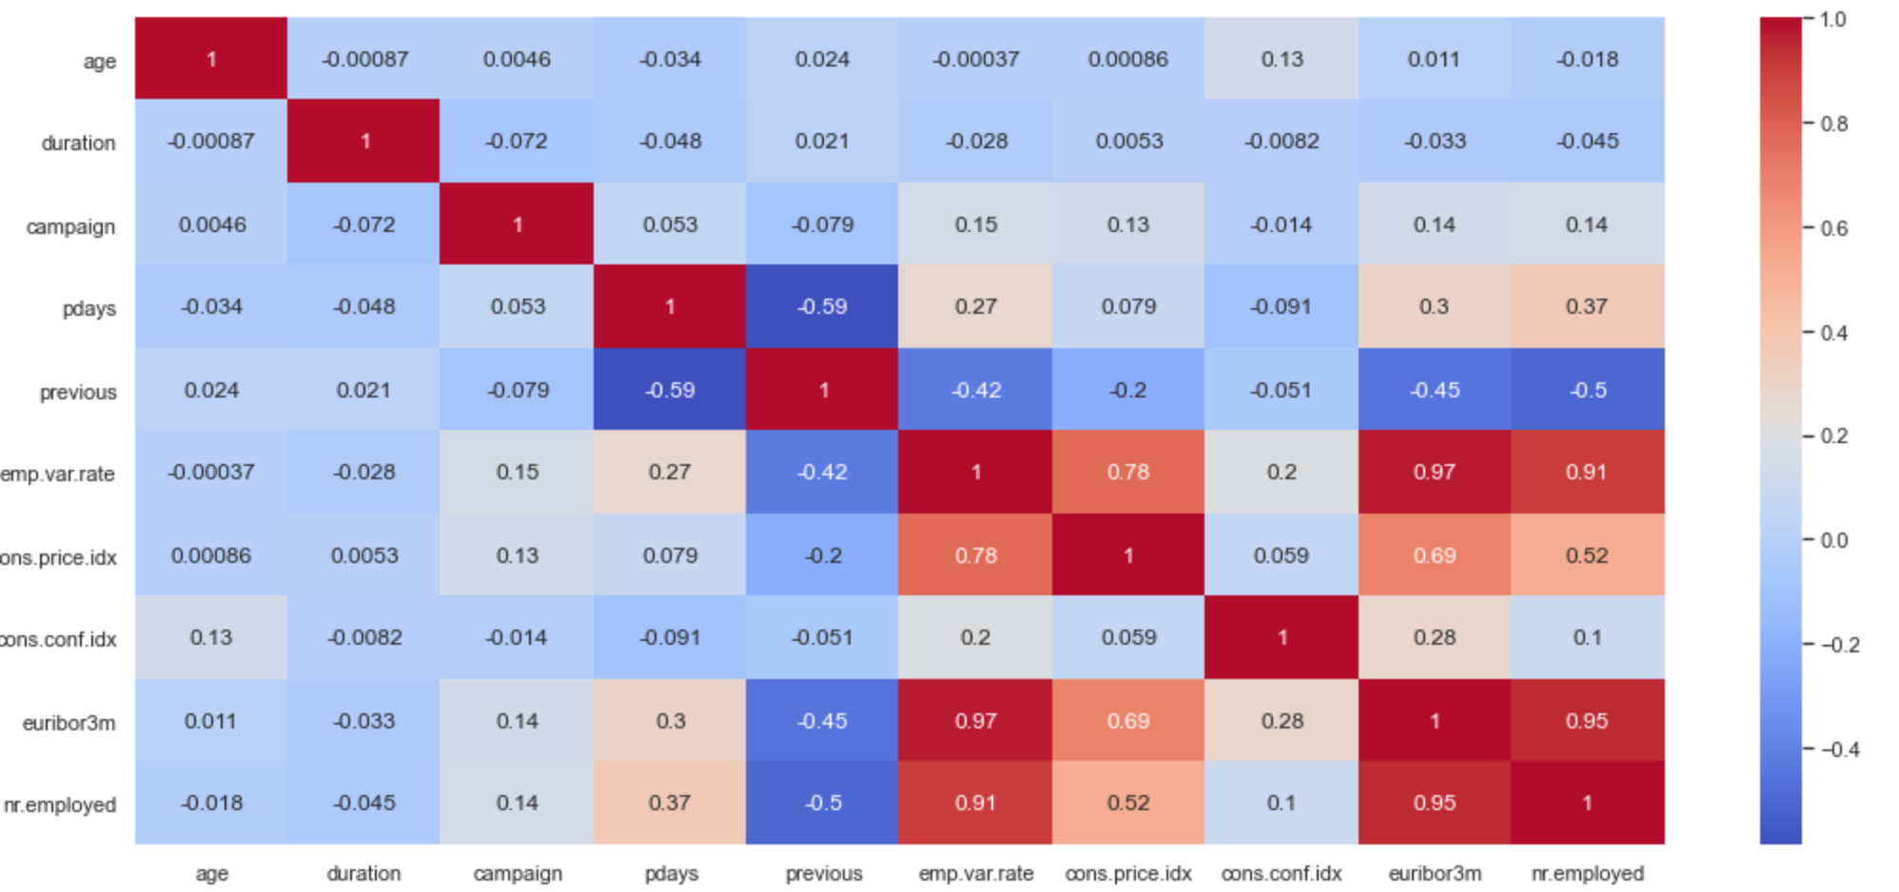
Project Approach > Exploratory Data Analysis
Executive Summary
Salary Distribution
P-Days Distribution
Duration Distribution
Project Approach
Overall Approach
Methodology
Key Takeaways
Prediction Variable Visualisation (Need for Stratification)
Predictor Correlation Heatmap
5

Slide 6
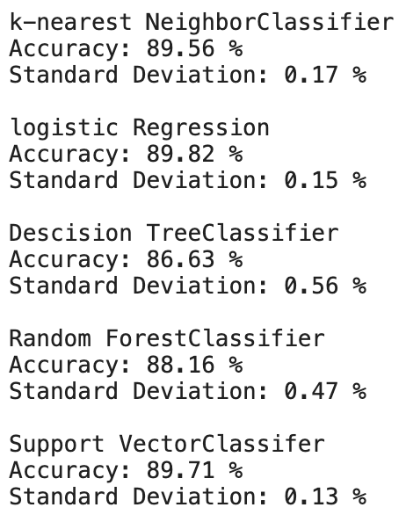
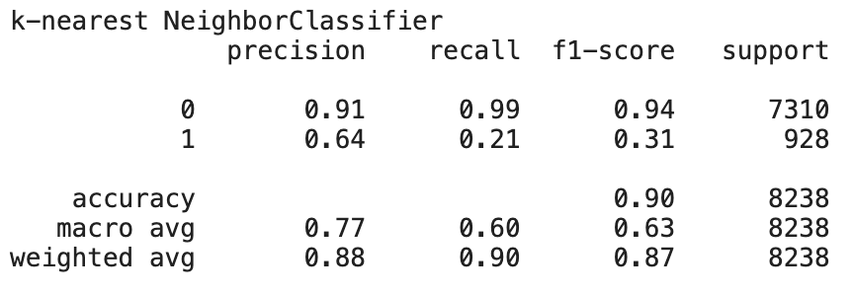
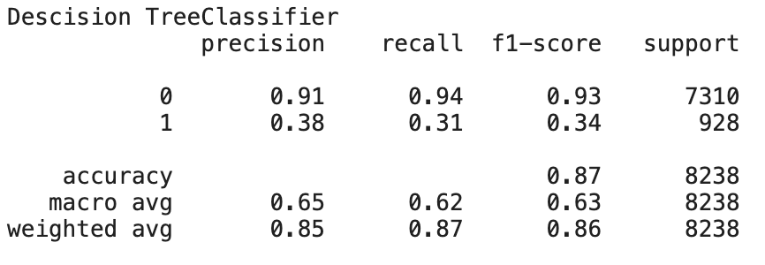
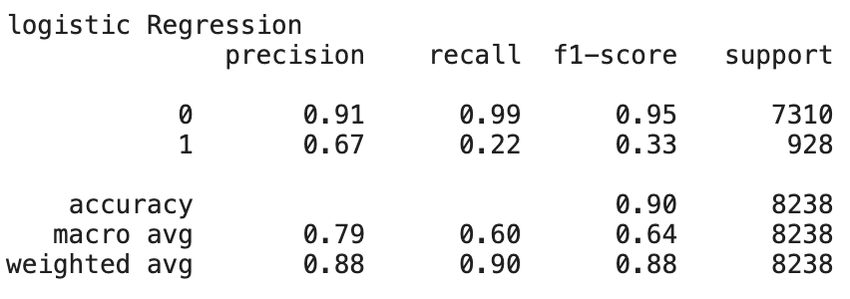
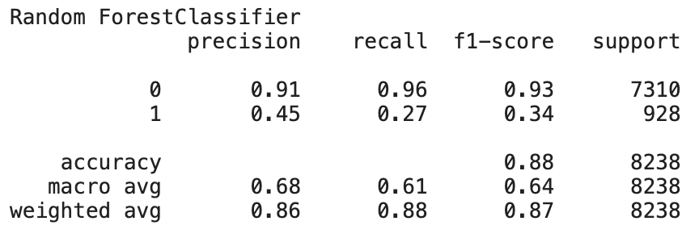
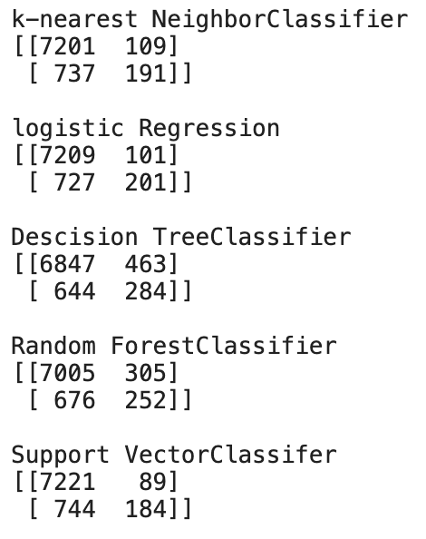
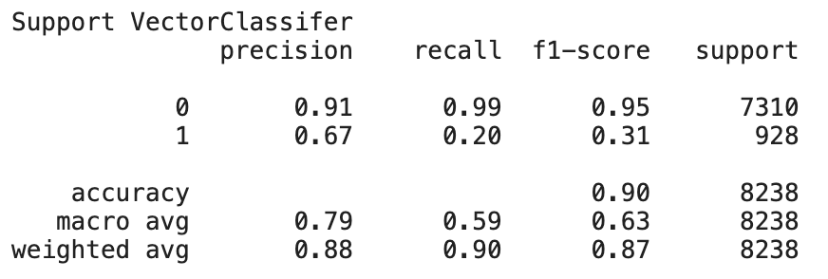
Project Approach > Model Output
Executive Summary
Cross Validation Output
K-Nearest Neighbour Classification Report
Decision Tree Classification Report
Project Approach
Overall Approach
Methodology
Key Takeaways
Logistic Regression Classification Report
Random Forest Classification Report
Confusion Matrix
Scalable Vector Machine Classification Report

Slide 7
Key Takeaways
Executive Summary
Conclusion
Model Performance
KNN, Logistic Regression and SVC arrived at almost same accuracy value after cross validation
Response value ‘y’
The response variable y was imbalanced hence the net to ‘stratify’ the dataset before modeling
Project Approach
Overall Approach
Methodology
Key Takeaways
Learnings
Coding Structure
Developed a structured modelling code structure that is organized and easy to maintain by including model object in dictionary objects
Modeling
Became more conversant with the model algorithms
Future Improvements
Other Modeling Techniques
Try out other classification algorithms
Feature Engineering
Perform additional feature engineering to improve model performance

Slide 8
Executive Summary
Project Approach
Key Takeaways
End

